Slide 1
Longest Common Substring

Slide 2
Problem Statement For Longest Common Substring
Given two strings, the objective is to find the longest substring that is common to both strings.
A substring is a sequence of characters that are continuous
The characters must appear in the same order and without gaps in both strings.
Since checking all possible substrings is inefficient, Dynamic Programming is used to store intermediate results.
The goal is to determine the maximum length of the longest common substring.

Slide 3
Brute Force Solution for Longest Common Substring
Idea
Generate all possible substrings of the given string.
Check which substrings are strictly increasing.
Find the maximum length among them.
Steps
Generate every possible substring (continuous elements).
For each substring:
Check if it is in strictly increasing order.
If yes, record its length.
Return the largest length found.

Slide 4
Continuation of Brute force for Longest Common Substring
Why this is Brute Force
A string of length n has O(n^2) substrings.
Each substring of x must be checked whether it exists in y.
Time Complexity
Generate substrings of x → O(n²)
Check each in y→ O(m)
Total → O(n² × m)
Space Complexity:
If substrings are stored → O(n²) Otherwise can be optimized to O(n) temporary space

Slide 5
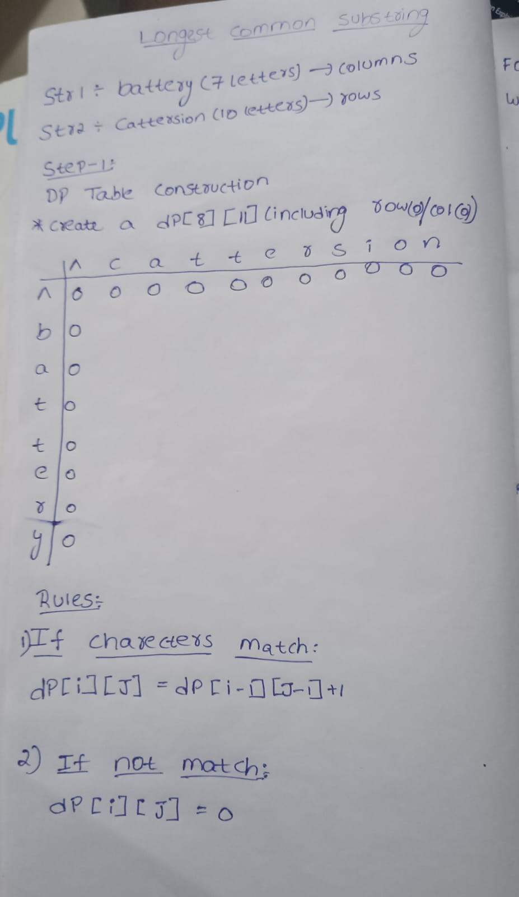
EXAMPLE FOR LCS USING DP
Input:
Str1 = battery
Str2 = cattersion
DP RULES:
1)If Charecters match:
Dp[i][j]=dp[i-1][j-1]+1
2)If not match:
DP[I][J]=0
SLIDE-11

Slide 6
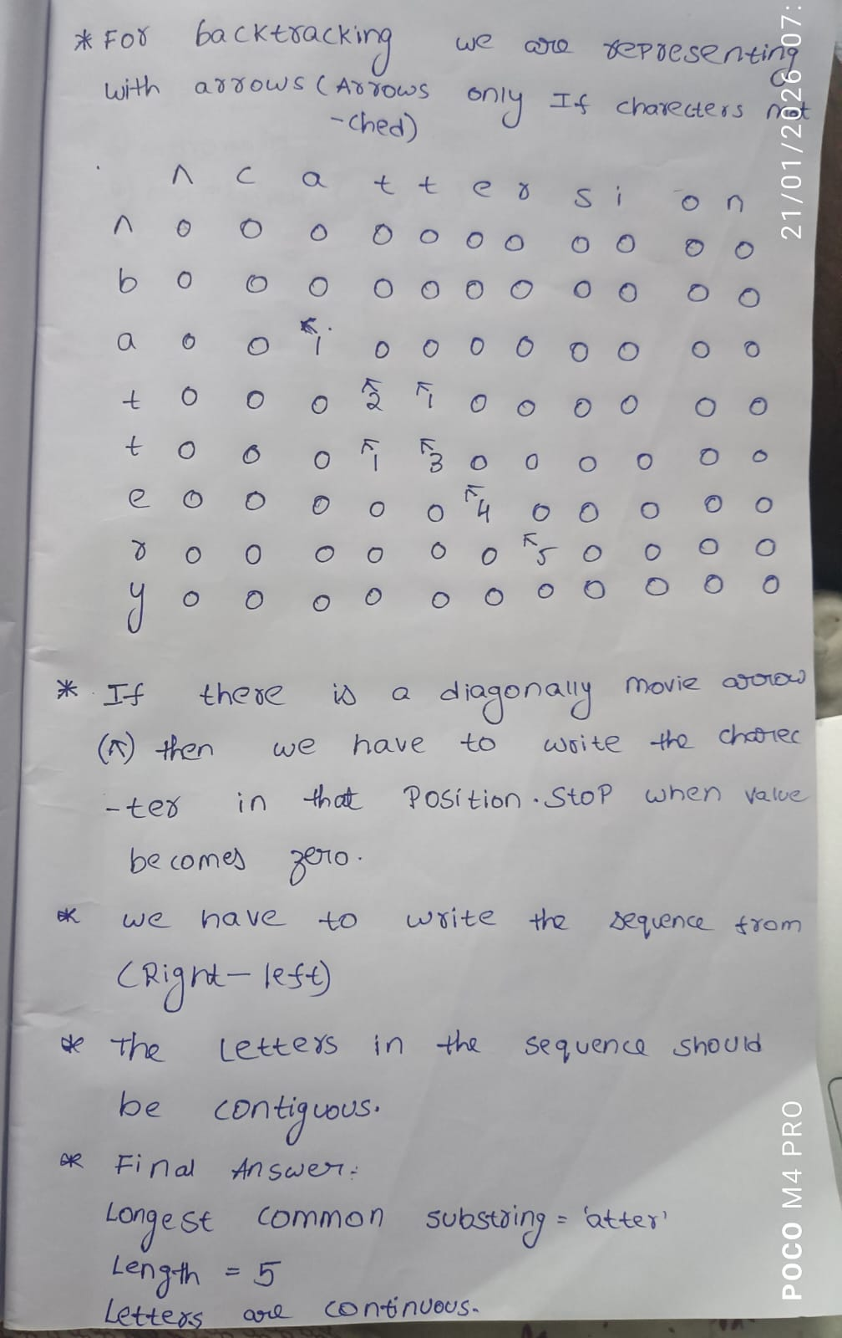
EXAMPLE FOR LCS USING DP

Slide 7
TIME COMPLEXTIES FOR LONGEST COMMON SUBSEQUENCE
Time Complexity:
We fill an m * n DP table
Each cell takes constant time
O(m * n)
Space Complexity:
DP table of size m * n
O(m * n)

Slide 8
Longest common substring using memoization(top-down)
Example:
X = "ABCDA" (length = 5)
Y = "ZABCXDA" (length = 7)
Memoization Formula:
L(i, j) = length of longest common substring
ending at X[i-1] and Y[j-1]
Rule:
If characters match:
L(i, j) = 1 + L(i-1, j-1)
If not match:
L(i, j) = 0

Slide 9
Continuation of Longest common substring using Memoization
Creating Memo Table:
Size = (n+1) × (m+1)
X\Y | 0 | Z | A | B | C | X | D | A
0 | 0 | 0 | 0 | 0 | 0 | 0 | 0 | 0
A | 0 | 0 | 1 | 0 | 0 | 0 | 0 | 1
B | 0 | 0 | 0 | 2 | 0 | 0 | 0 | 0
C | 0 | 0 | 0 | 0 | 3 | 0 | 0 | 0
D | 0 | 0 | 0 | 0 | 0 | 0 | 1 | 0
A | 0 | 0 | 1 | 0 | 0 | 0 | 0 | 2

Slide 10
Continuation of Longest common substring using Memoization
1)A in str1 matches A in str2
L(1,2) = 1
2)B matches B
L(2,3) = 1 + previous = 2
3)C matches C
L(3,4) = 1 + previous = 3
So substring:
ABC
Length = 3

Slide 11
Complexities
Time Complexity:
Let:
n = 5
m = 7
Total states:
n × m
Time Complexity = O(nm)
Space Complexity:
Memo table → O(nm)
Recursion stack → O(n + m)
Total:
Space Complexity = O(nm)

Slide 12
Tabulation
Optimization of Tabulation:
While computing dp[i][j], it is not necessary to check left or up cells.
We only check:
dp[i-1][j-1] (diagonal)
Because substring must be continuous.
If characters don’t match : we directly put:
dp[i][j] = 0
So computation is simple and fast.

Slide 13
Time Complexity for Tabulation:
▪ Initialization Cost
Create DP table of size:
(n+1) × (m+1)
Initialization cost:
O(nm)
▪ Nested Loop Cost
Outer loop → runs n times Inner loop → runs m times
Total executions:
n × m
So,
Time Complexity = O(nm)
For our example:
O(5 × 7) = O(35)

Slide 14
Space Complexity for Tabulation:
DP table size:
(n+1)(m+1)
So,
Space Complexity = O(nm)

Slide 15
Backtracking in Tabulation
To find the substring after DP is filled:
We only need:
The maximum value
Its position (i, j)
No need of extra prev[] array (because substring is continuous)

Slide 16
Example (HELLO, YELLOWX)
From DP table:
Maximum value = 4
It occurs at:
dp[5][5] = 4
This means substring length = 4 ending at position 5 in X.
How Backtracking is Done
▪ Start from maximum index
i = 5, j = 5
Character = O
▪ Move diagonally
Go to:
dp[4][4] = 3
Character = L

Slide 17
Example continuation
Move diagonally
dp[3][3] = 2
Character = L
▪ Move diagonally
dp[2][2] = 1
Character = E
▪ Reach value 0 → Stop
Final Result
Collected characters (reverse order):
O L L E
Reverse it:
ELLO

Slide 18
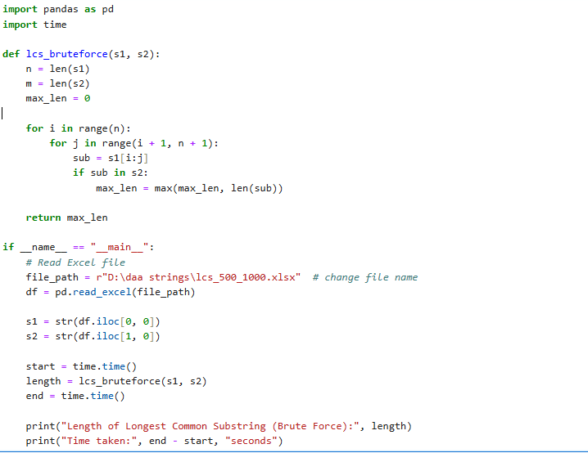
BRUTE FORCE CODE FOR LONGEST COMMON SUBSTRING

Slide 19
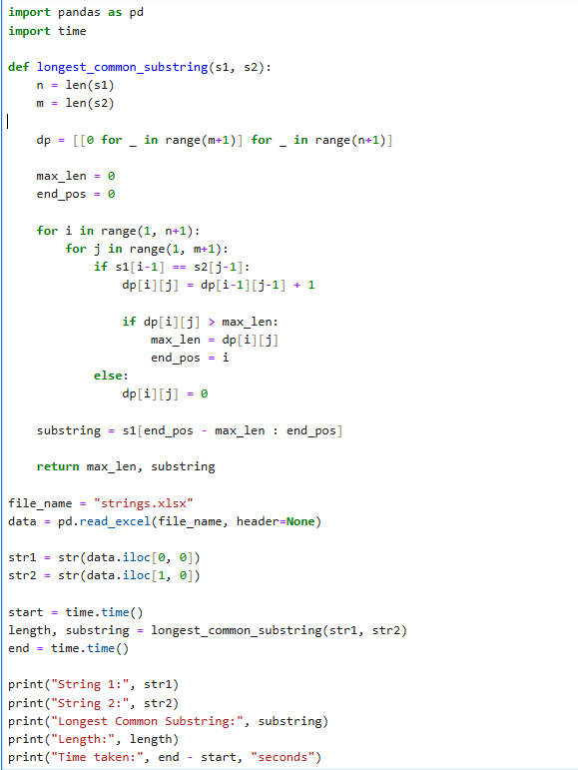
DP CODE FOR LONGEST COMMON SUB STRING

Slide 20
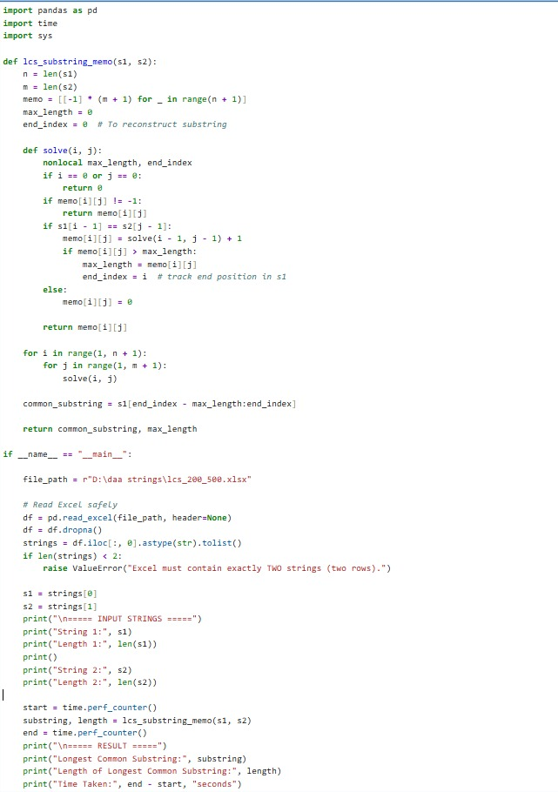
MEMOIZATION CODE FOR LONGEST INCREASING SUBSEQUENCE

Slide 21
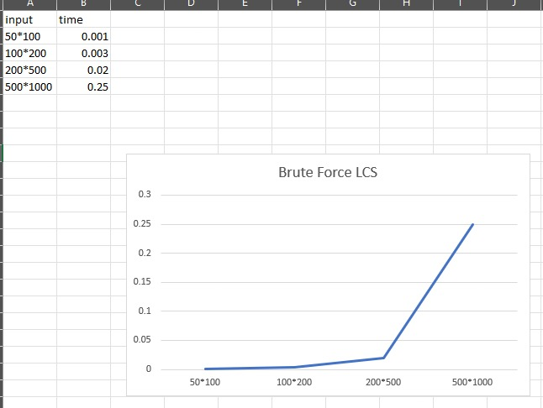
BRUTE FORCE TIME COMPLEXITY USING LONGEST COMMON SUB STRING

Slide 22
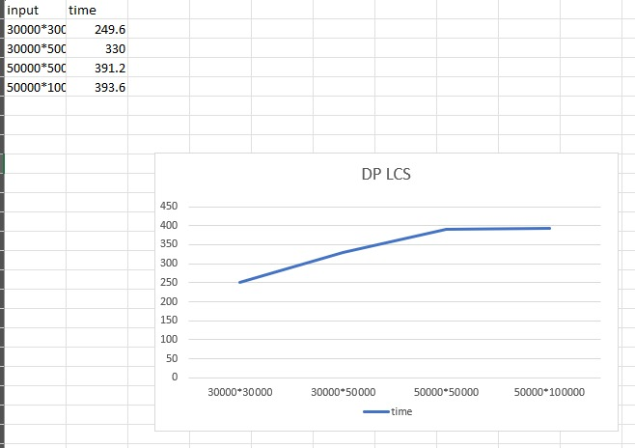
DP TIME COMPLEXITY FOR LONGEST COMMON SUBSTRING

Slide 23
Table comparison between the two solutions
Approach | Time Complexity | Space Complexity | Explanation
Brute Force | O(n^2*m) | O(n) | Generates all possible subsequences of the first string and checks which ones are common with the second string.
Dynamic Programming | O(m * n) | O(m * n) | Uses a DP table to store LCS lengths of prefixes of both strings and reuses previously computed results.

Slide 24
Observation (Longest Common Substring):
Brute force approach becomes impractical for large input strings due to exponential time complexity.
Dynamic Programming significantly reduces computation by solving overlapping subproblems.
DP provides a much faster and more practical solution for finding LCS.
Hence, Dynamic Programming is preferred for real-world LCS problems.

